Slide 1

Quantum Decision Making
Mohsen Izadyari
Introduction of Quantum walk: its application on search and decision-making

Slide 2


Decision making is the process of making choices by identifying a decision, gathering information, and assessing alternative resolutions.
Economy
Psychology
Law
Marketing
Management
A prisoner's dilemma is a situation where individual decision-makers always have an incentive to choose in a way that creates a less than optimal outcome for the individuals as a group. The prisoner's dilemmas occur in many aspects of the economy.

Slide 3
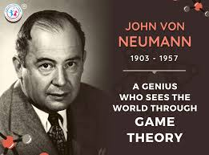


Slide 4
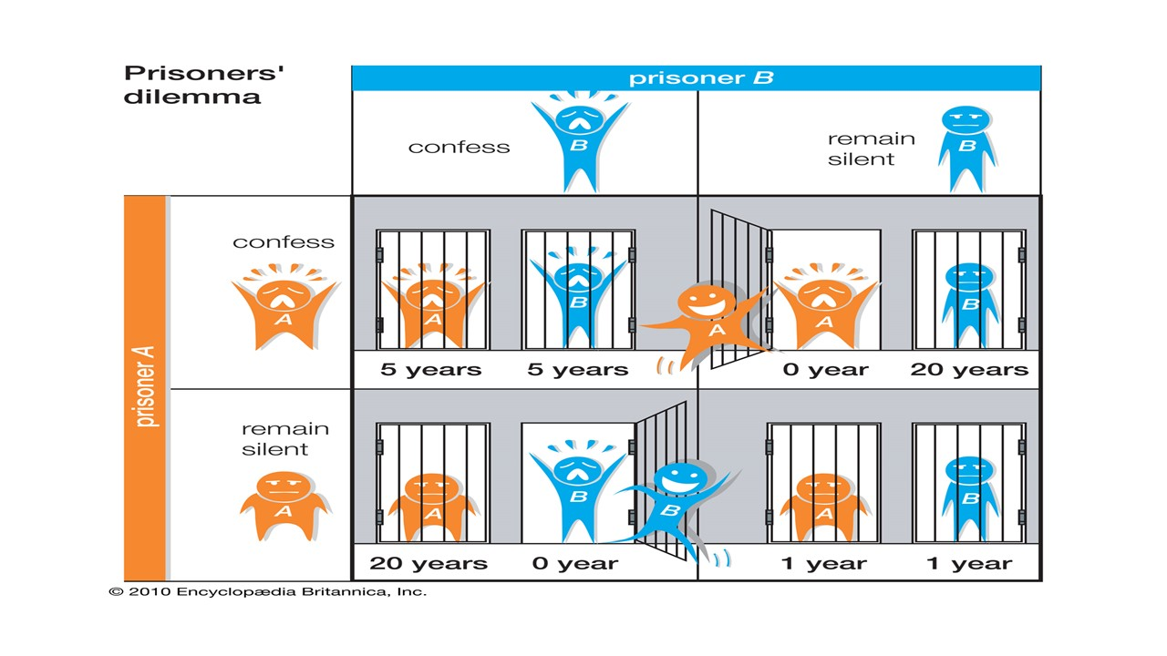

Slide 5
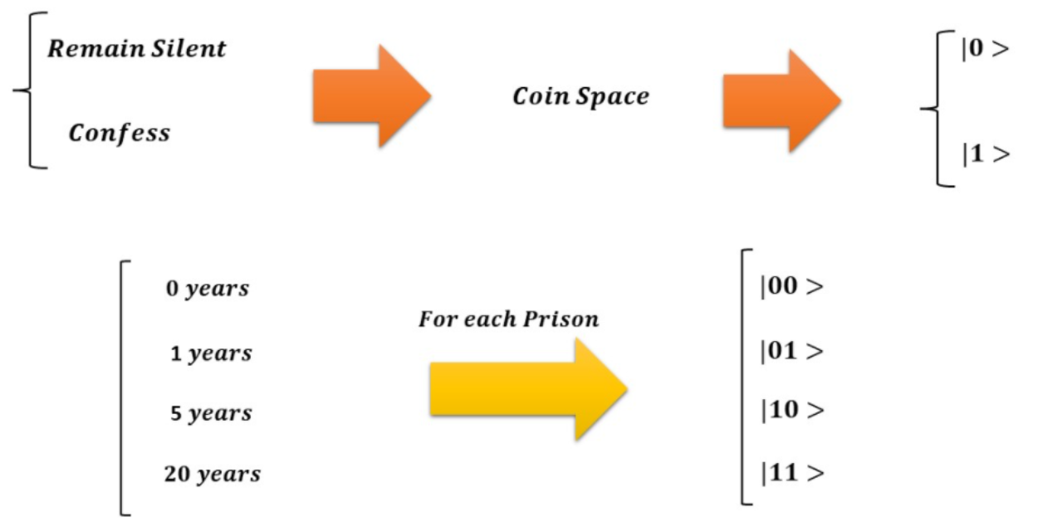

Slide 6
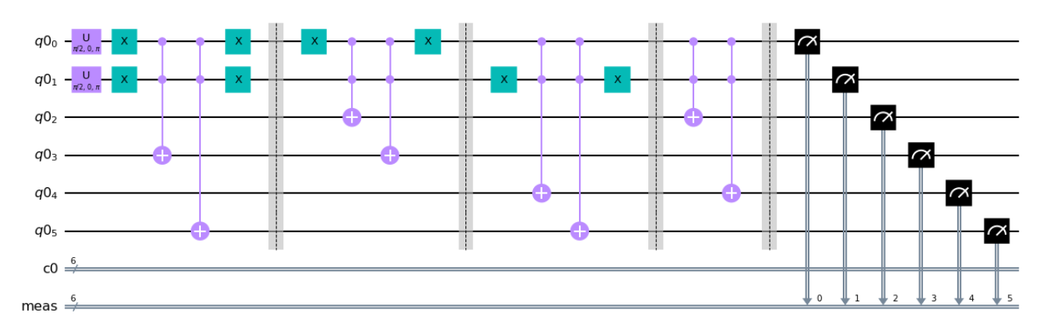
Decision-Making Quantum Circuit

Slide 7
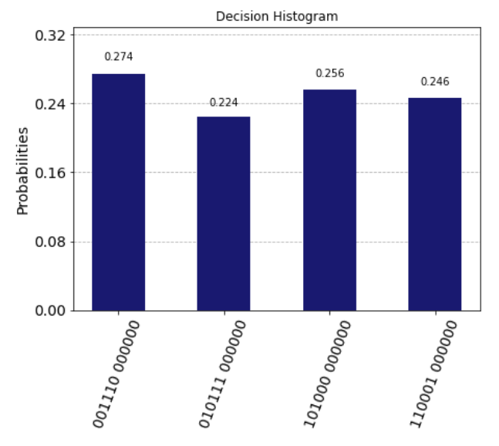
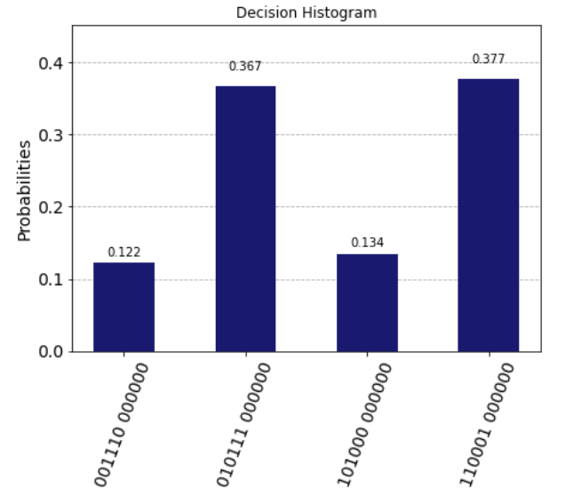
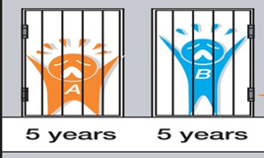
Two symmetric Coin
A symmetric Coin and an asymmetric U-gate coin

Slide 8


Thank you!

